Slide 1
Women and Torture
IFLN Webinar, 14 June 2023
Dr. Nicole Bürli, nb@omct.org

Slide 2
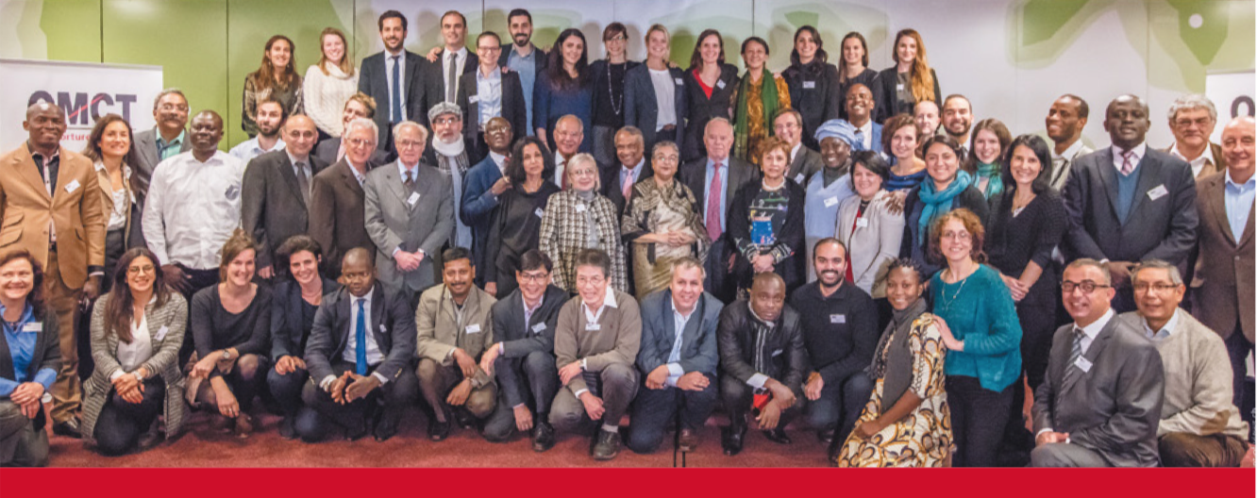
World Organisation against Torture
Funded in 1986 in Geneva (headquarter), offices in Brussels and Tunisia
Network with more than 200 members and partners in 90 countries
Programs: Anti-Torture Program, Human Rights Defenders Program, Child Rights Program (juvenile justice), Victim’s Fund

Slide 3
Violence against Women under the CAT Convention
Drafting history of the Convention against Torture Convention shows it was primarily intended to protect male prisoners
In the 1990s, OMCT received more and more cases of violence against women and studied more systematically
Reluctance by the CAT and Special Procedures and lack of information to include VAW by non-state actors in state review procedures
public/private divide in human rights law

Slide 4
Violence against Women under the CAT Convention
First mention of VAW by CAT was in 2001 in Concluding Observations to
Greece: The Committee recommends that “steps be taken to prevent and punish trafficking of women and other forms of violence against women”.
Georgia: The Committee recommends: “effective measures be taken to prosecute and punish violence against women as well as trafficking in women, including adopting appropriate legislation, conducting research and raising awareness of the problem as well as including the issue in the training of law enforcement officials and other relevant professional groups”.

Slide 5
Due Diligence
In 2008, CAT issued General Comment No.2 (authoritative interpretation of the Convention) explaining due diligence principle
“where state authorities or others acting in an official capacity . . . have reasonable grounds to believe that acts of torture . . . are being committed by . . . private actors, and . . . fail to exercise due diligence to prevent, investigate, prosecute and punish such non-state officials or private actors consistently with the convention, the State bears responsibility and its officials should be considered as authors, complicit or otherwise responsible under the Convention for consenting to or acquiescing in such impermissible acts"

Slide 6
Definition of Torture and CIDT
Torture (Art. 1) | CIDT (Art. 16)
Pain and Suffering (physical or mental) | Pain and Suffering (physical or mental)
Public Official (by a public official or at its instigation, or with the consent or acquiescence of a public official or other person acting in an official capacity) | Public Official (by a public official or at its instigation, or with the consent or acquiescence of a public official or other person acting in an official capacity)
Intention | -
Purpose (e.g. confession, discrimination, punishment) | -

Slide 7
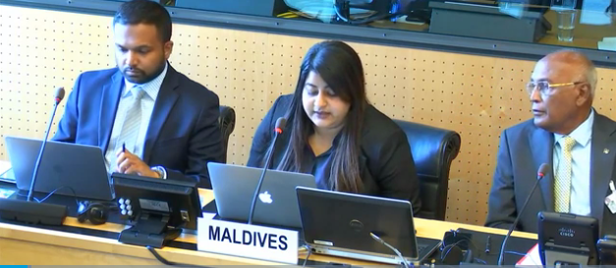
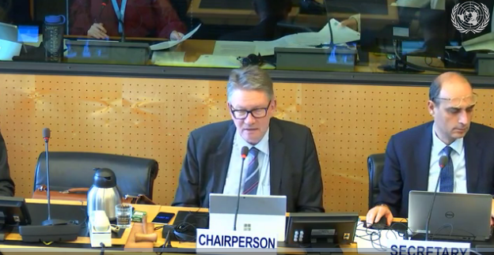
CAT Recommendations on VAW
Child and forced marriage
Domestic violence
Rape
Trafficking
Reproductive violence (forced sterilization, ban on abortion), FGM
Violence during war and conflict
Honor crimes
Gender-based violence by state actors (e.g. in detention, at demonstrations etc.)

Slide 8
Use of CAT by Women’s Rights
Despite the CAT addressing violence against women not many women’s rights organisations are making use of the CAT (State reviews)
from 2015-2021, the CAT reviewed 92 countries, women’s rights organisations only submitted alternative reports in 50% of these.
Of the 969 organisations that submitted alternative reports (either single or joint reports with other CSOs) to these 92 country reviews, only 148 (or 15%) were organisations that specifically deal with women’s rights.
CAT not well informed about the root causes of VAW in a specific country and can consequently not formulate relevant and specific recommendations on how to address those root causes

Slide 9
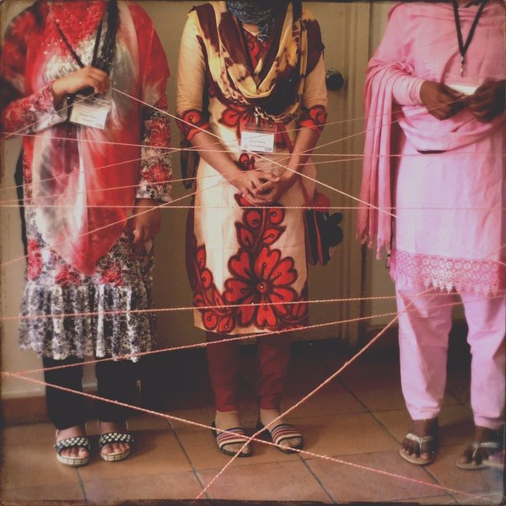
Use of CAT by Women’s Rights
OMCT’s mission to reach more women’s rights organisations and lawyers to use anti-torture framework including CAT when in context of VAW because:
Special stygma and gravity
No exception or justification
Obligation to criminalize and prosecute
Obligation to redress and provide rehabilitation
Obligation to take preventative measures that address the root causes
Adding torture perspective adds other actors

Slide 10
Domestic Impact of CAT on VAW
Involvement of women rights organisations produce better concluding observations and make it more likely that they are involved in implementation domestically
Recommendations by CAT on VAW has resulted in positive effects domestically.
Venezuela: CAT recommended to incorporate the crime of femicide into the law;
recommendations on shelters useful for domestic NGOs in lobbying and advocating in their country,
virginity testing prohibited

Slide 11
State Violence against Women and Detention
CAT does not systematically addressed state violence against women and detetnion conditions
Not many CSOs report on violence by public officials to CEDAW hence it does not consistently address women’s situations in detention, police violence, sexual violence during conflict, violence by the army and other forms of ill-treatment and torture inflicted by the government.
From 2017 to 2021, CEDAW reviewed 79 member States. In its concluding observations, addressed State led violence in one third (26, i.e 34%) of the States reviewed.
Conditions of detention and other detention related gender-based violence mentioned in seven (9%) concluding observations.

Slide 12
Litigation for VAW before the CAT
Hardly used by women
From 2015 to 2021, the CAT decided 293 cases and only 32 (11%) of those were submitted by a female victim.
Of those 32 cases, only in 14 cases did the complainant allege gender-based torture or other gender-based ill-treatment

Slide 13
Litigation Barriers
Legal barriers: VAW in domestic law not considered as torture. E.g. rape by a police officer in Bangladesh is criminalized under Suppression of Repression against Women and Children Act 2000 and not under Torture and Custodial Death (Prevention) Act 2013
Practical:
Access to lawyer
No independent financial resources
Lack of gender-sensitive justice systems (patriarchy, discrimination, re-victimisation)
Lack of gender-sensitive rehabilitation, redress, and shelters
Lack of support for women human rights defenders

Slide 14
Resources
OMCT and PAHRA, Women Break the Silence. Gender-Based Torture in Asia, 2022: https://www.omct.org/site-resources/legacy/Gender-based-Torture-in-Asia.pdf
Washington College of Law, Center for Human Rights and Humanitarian Law, Gender Perspectives on Torture: https://www.wcl.american.edu/impact/lawwire/gender-perspectives-on-torture-law-and-practice/gender-perspectives-on-torture/
Report of the SR Torture, Gender perspectives on torture and other cruel, inhuman and degrading treatment of punishment, 2016: https://documents-dds-ny.un.org/doc/UNDOC/GEN/G16/000/97/PDF/G1600097.pdf?OpenElement

Slide 15
Thank you for your Attention

Slide 16
State-led violence before CEDAW
State violence and detention conditions of women not systematically addressed by CEDAW
From 2017 to 2021, CEDAW reviewed the compliance with the Convention on the Elimination of All Forms of Discrimination Against Women (CEDAW Convention) of 79 member States.
State led violence addressed in one third (26, i.e 34%) of the States reviewed.
conditions of detention and other detention related gender-based violence were only mentioned in seven (9%) concluding observations.

